Slide 1
WHAT’S COOKING?
“the next best recipe app”
Sebastian Dabrowski, Ryan Buraus, Wissam Mateen, Jackie Shao, Angela Fong

Slide 2

What’s Cooking?
Running out of ideas for food? Look no further.This app is designed to solve all your food troubles. It has a wide database with various recipes to match whatever ingredients you have at home. Make recipes that you have never thought of before and enjoy the simplicity of it, all one click away.

Slide 3




Bad Boys 4 Life
Ryan Buraus
Angela Fong
Sebastian Dabrowski
USER INTERFACE
GRAPHICS DESIGN
SCRUM MASTER
Wissam Mateen
Jackie Shao
QUALITY TESTER
DATABASE MANAGER

Slide 4
FUNCTIONALITIES
What does the application do, and how quickly does it do it?
What are possible failure conditions and how are they handled?
What one-time operations are done at the first execution (i.e., after installation)?
If the user creates entries of any kind (e.g., bookmarks), what are the limitations?

Slide 5
FUNCTIONS &
FEATURES
1
The application is designed to cater to people with a limited ingredient list by providing a quick and easy way to find recipes that suit their tastes without the extra trips to the supermarket.
Possible failure conditions could a non-registered ingredient in our database. It is also possible that certain combinations of ingredients don’t lead to a recipe. This could be fixed by offering similar recipes that still caters to most of the client’s needs.
2
3
One-time operations after installation is limited since this app does not need an login/account to be utilized. However, future implementations could include bookmarks and saved ingredient searches.
4
If user could create entries such as bookmarks, there should a cap albeit a large and reasonable one. This is to prevent the app from lagging and becoming too slow to execute.

Slide 6
MILESTONES
Firebase
Splash Screen
Ingredient List
Search
Recipe Activity
Constructed a database to hold basic ingredients and recipes
Includes app logo and name. Loads into activity list after approx. 3 secs!
User is given the ability to add ingredients in the app
User is able to conduct an ingredient search with a drop down
Tapping on a listed recipe that matches with the user’s request should display the data stored for that recipe (name, ingredients, instructions, as well as
visual image)
S1.0
S3.0
S4.0
S5.1
S6.0
Notes:
Jackie:
We first started with the database on a shareable platform, Firebase. Team members came together to figure out which ingredients were the most common in households and thought of recipes containing those ingredients. Next we worked on the splash screen that transitions from displaying our app’s logo and name to the next screen. We then worked on developing the next screen, which is the ingredients list where the user can choose which ingredients to include into the search. Our next development is the search activity. Now the user is able to search for recipes in the database that match the chosen ingredients. Lastly, our team worked on the recipe activity which is for when the user selects a desired recipe. This activity displays the stored data, which includes the name, ingredients and instructions of the recipe.

Slide 7

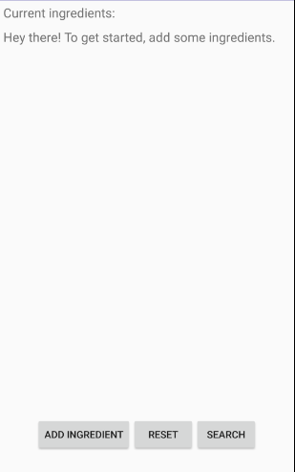
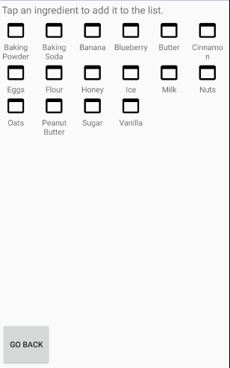
App Layouts
Insert screenshot here
Insert screenshot here
Welcome Screen
Home Screen
Ingredient List

Slide 8
App Testing
100%
Phase 2
Queried database for recipes including user selected ingredients. Results should display a match.
75%
Phase 1
Stored ingredients and recipes in firebase firestore in standardized format and tested firebase connection with app to ensure it is working.
Phase 4
Fully functioning search that displays recipes along with data stored for that recipe. Future improvements can include bookmarking or saving recent searches for easy user access.
50%
Phase 3
Displayed queried recipes in a list and individual recipe details in a dedicated activity. User should be able to conduct their own ingredient search.
25%

Slide 9
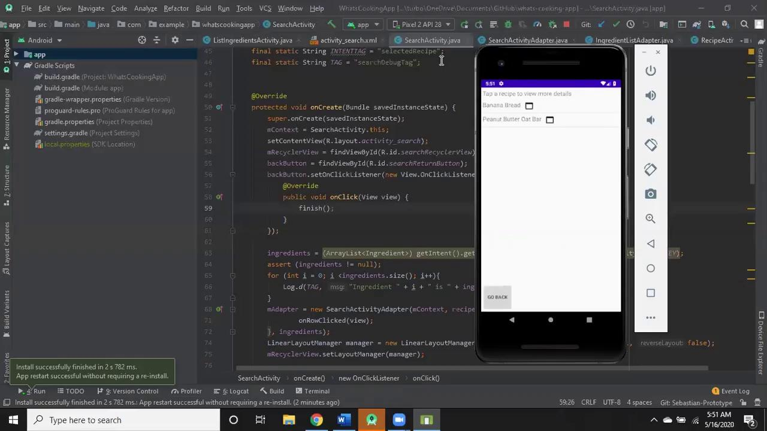
VIDEO DEMONSTRATION
WHAT’S COOKING
Upon opening What’s Cooking, a title screen with the version number in the top right corner will appear. On the main screen, there are options to input ingredients along with three buttons; add, reset, and search button. When you add an ingredient, there is a menu that lists the ingredients available in the database. From there, you can add your selected ingredients and/or return to the previous screen when done.
When the user is finished appending all the ingredients to be searched, the second screen will display all the matching recipes for the user to choose from. A modify search button is included if the user wishes to change the ingredients searched. If a recipe is chosen, another screen displays the name of the recipe, a picture, estimated cooking time, a description and instructions. There is another back button that brings the user to the second screen. There is also a finish button that brings the user to the main screen.

Slide 10
“a cooking app that overachieves”
GITHUB
WHAT’S COOKING
https://github.com/rjburaus/whats-cooking-app

Slide 11
What’s Cooking?
Thank you!
“Anyone can cook”

